Slide 1

RISK DOMINATION BUILD 2 TEAM U7 SOEN 6441 FALL 2023 Submitted to: Dr. Amin Ranj Bar
40261785 – ABHISHEKKUmar MAVANI
40226105 - AKSHARKUMAR PATEL
40230415 - KARNIK SHAH
40231114 - SHREY Agrawal
40274495 - SHUBH thummar
40265305 - UMANG savlA

Slide 2
FLOW OF THE PRESENTATION
1. Architectural design of the Project.
a) State Pattern
b) Observer Pattern
c) Command Pattern
2. Demonstration of functional requirements.
3. Coding Conventions and tools used.
4. Discussion of Refactoring document.

Slide 3
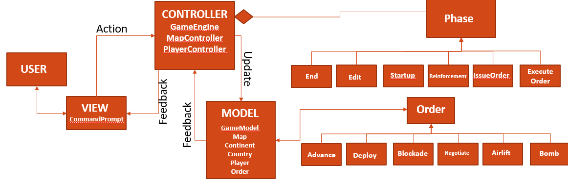
ARCHITECTURAL DESIGN
Phase
Bomb
MODEL – VIEW – CONTROLLER ARCHITECTURE

Slide 4
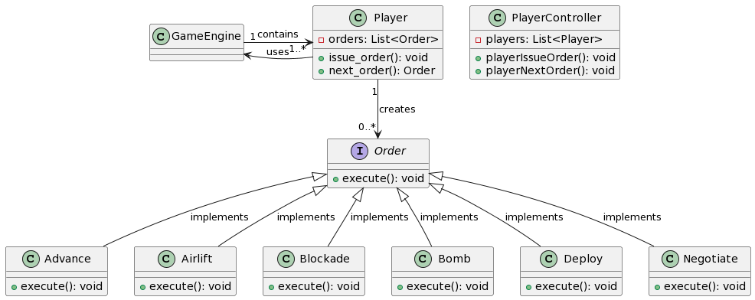
Command Pattern

Slide 5
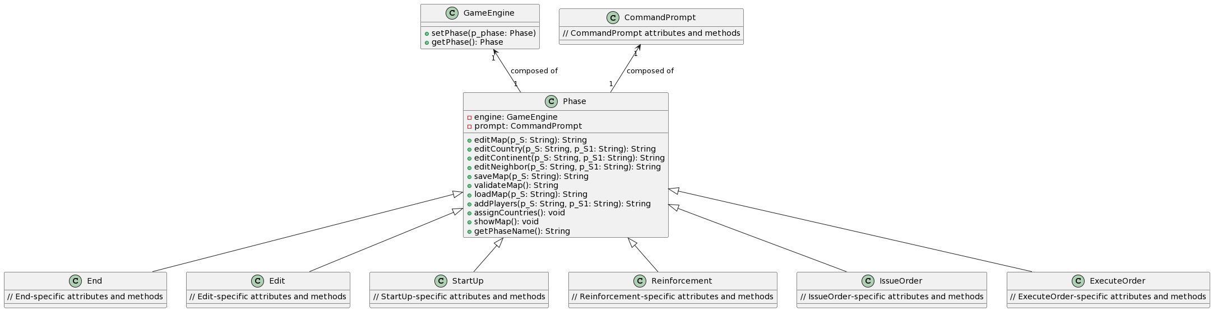
State Pattern

Slide 6
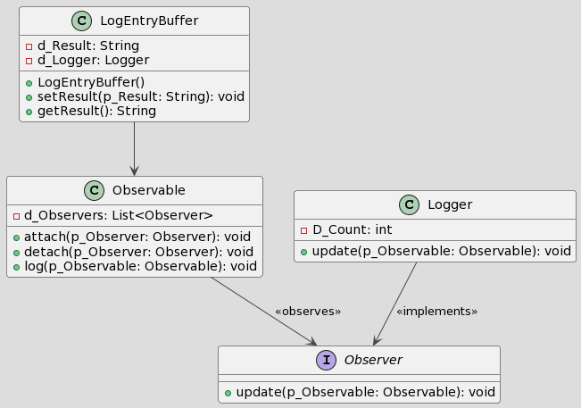
Observer Pattern

Slide 7
CODING CONVENTIONS AND TOOLS USED
Class names in CamelCase that starts with a capital letter.
Data members start with d_ .
Method parameters start with p_ .
Local variables start with l_ .
Static members start with a capital letter, non-static members start with a lower case letter.
For version control we have used EGit (Eclipse Git) and Github.
For documentation we have used Javadoc.
For unit testing we have used JUnit.
For Continuous Integration we have used Github Actions.

